Slide 1
Job hunt 2022; a case review
Joaquín González; May, 2nd, 2022

Slide 2

Refers to the decisions of millions of workers to quit their jobs during the pandemic.
- Anthony Klotz¹

Slide 3

More info on the Great Resignation
World Economic Forum
Resignation rates are highest in the technology and healthcare industries²
The Future of Jobs Report 2020
Skills gaps continue to be high as in-demand skills […] such as:
Critical thinking and analysis
Problem-solving
Active learning
Resilience
Stress tolerance
Flexibility⁴
Age range: 30 – 45 years old
Harvard Business Review³
Notes:
Harvard Business Review
Employees between 30 and 45 years old have had the greatest increase in resignation rates, with an average increase of more than 20% between 2020 and 2021.³

Slide 4

Change?
What to do? Where to go?
Notes:
https://olbios.org/change-and-the-world-changes-with-you/ - Image source

Slide 5
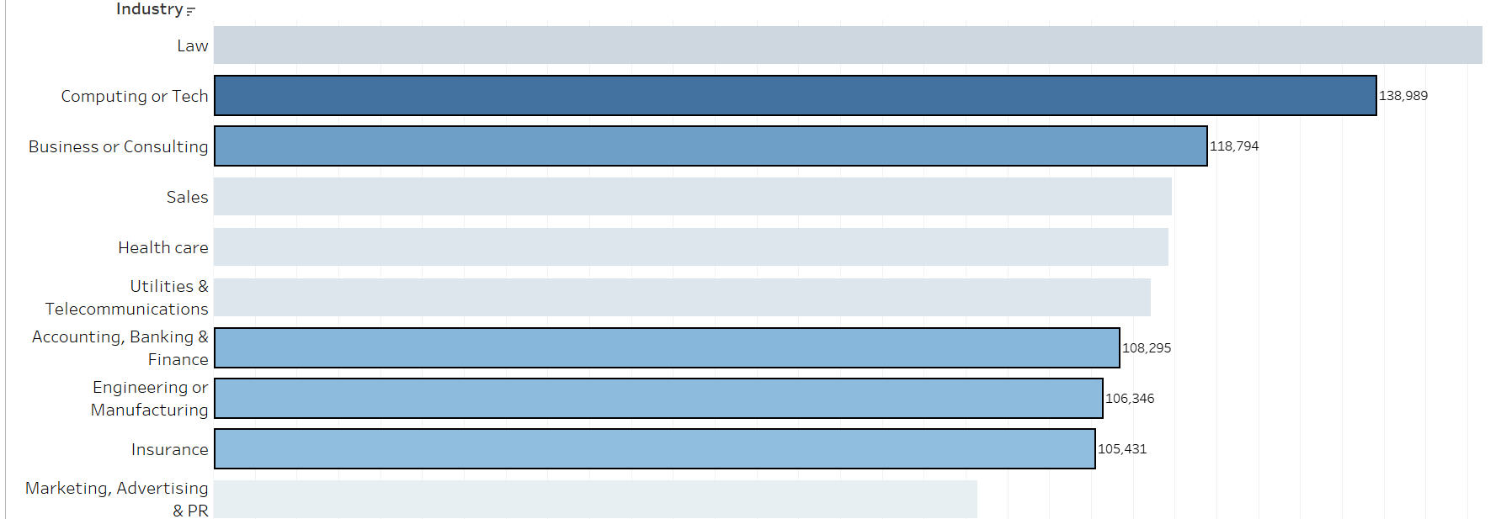
Top 10 Industries with highest annual salary per manager in USD⁵
Currently in training
My professional background

Slide 6
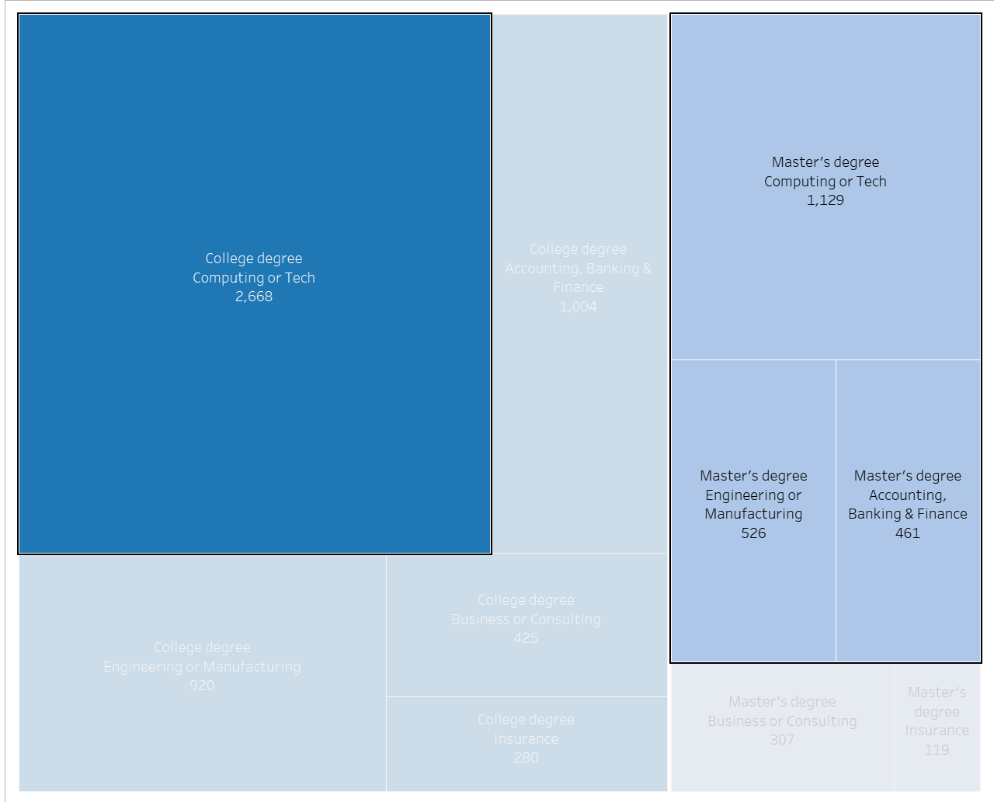
Exploit my academic background
Industry – Education Level⁵

Slide 7
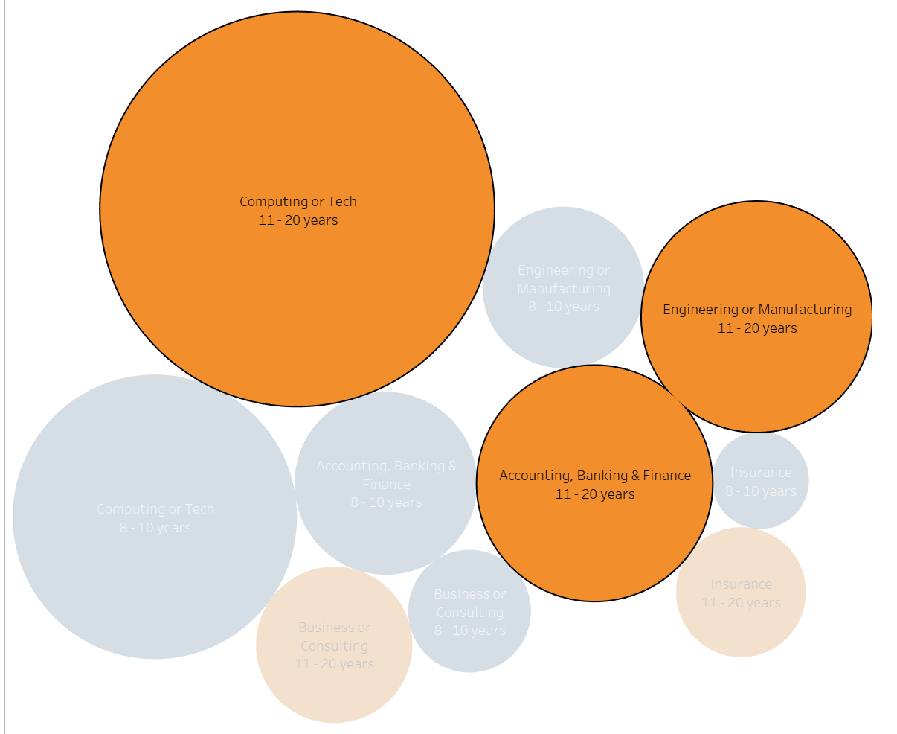
Supported by years of experience
Industry – Total years of experience⁵

Slide 8
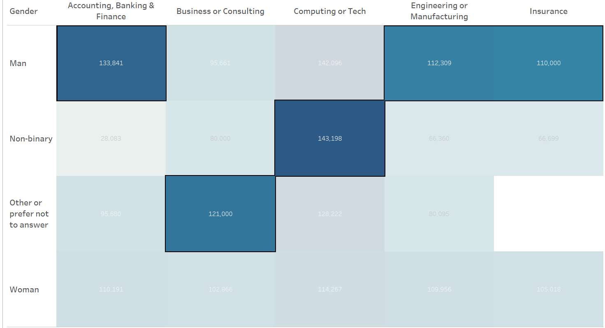
Competition: Salary differences by Gender
Salary by Industry – Gender⁵

Slide 9

Conclusion
Past
Present
Future
Leave old job: aligned with global trend
Train in Computer and Tech sector
Look for work:
The Future of Jobs Report 2020
Roles with increasing demand across industries, top 3:
Data Analyst and Scientist
AI and ML Specialist
Big Data Specialist⁴
👍
👍
👍

Slide 10
Thank you
Any questions?

Slide 11
Sources:
https://today.tamu.edu/2022/02/11/the-texas-am-professor-who-predicted-the-great-resignation/, extracted on Apr, 29th, 2022
https://www.weforum.org/agenda/2021/11/what-is-the-great-resignation-and-what-can-we-learn-from-it/, extracted on Apr, 29th, 2022
https://hbr.org/2021/09/who-is-driving-the-great-resignation, extracted on Apr, 29th, 2022
https://www.weforum.org/reports/the-future-of-jobs-report-2020/in-full/executive-summary, extracted on Apr, 29th, 2022
https://oscarbaruffa.com/messy/, Database: 'Ask A Manager Salary Survey 2021 (Responses)' downloaded on April, 20th, 2022

